Slide 1
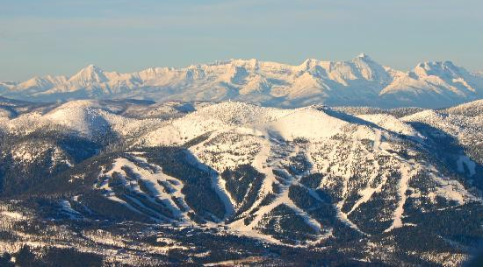

Slide 2

Big Mountain Resort Project Presenter: Hui Zhang Date: August 08,2023

Slide 3
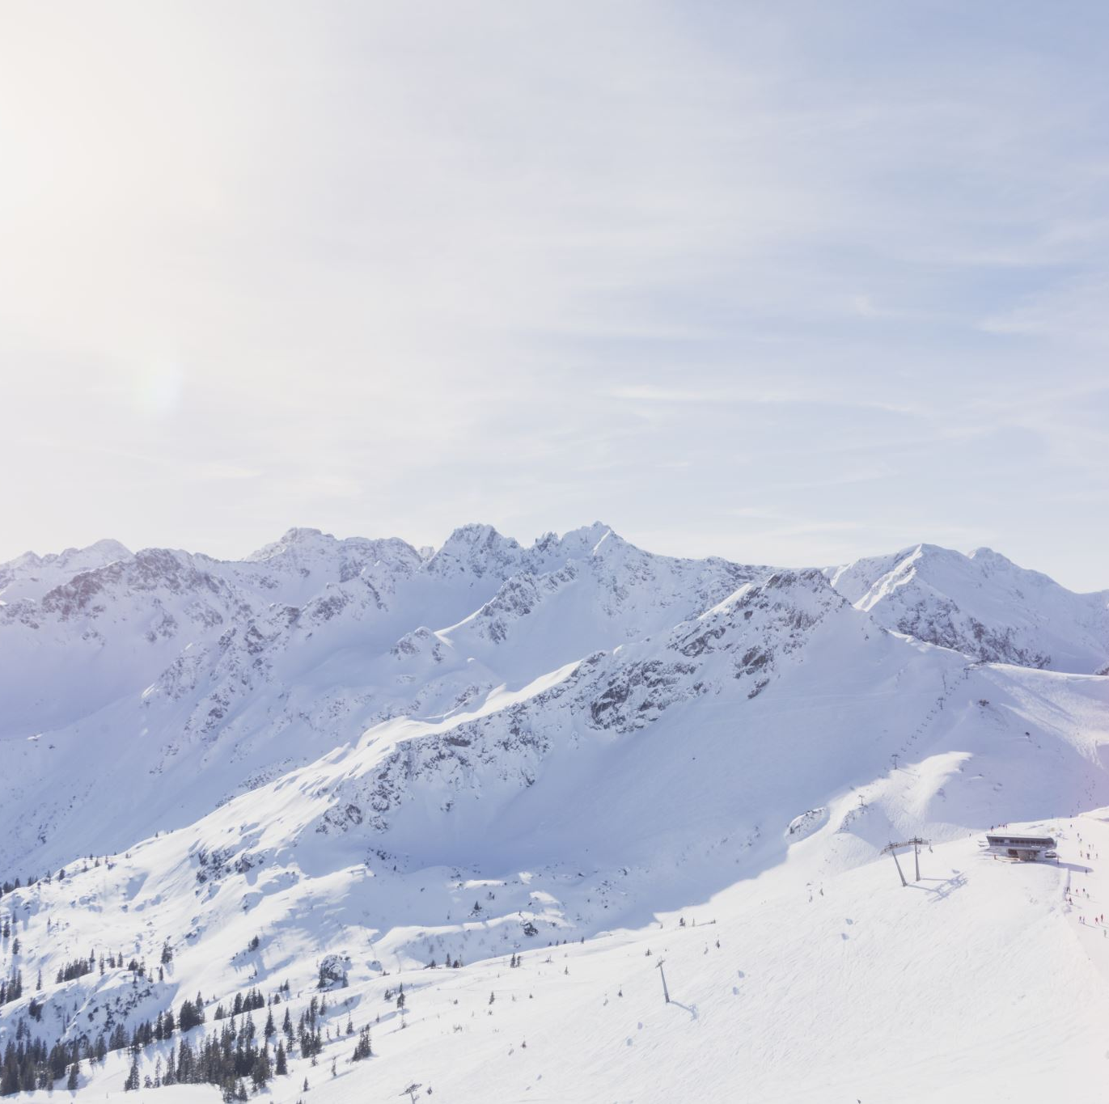
Problem Identification
Big Mountain resort is a ski resort located in Montana, which has 105 trails and serves 350000 people every year. There's a suspicion that the resort is not capitalized on its facilities as much as it could. The management want some guidance on how to select a better value for their ticket price. They are also considering changes that can either cut costs without undermining the ticket price or support an even higher ticket price.

Slide 4
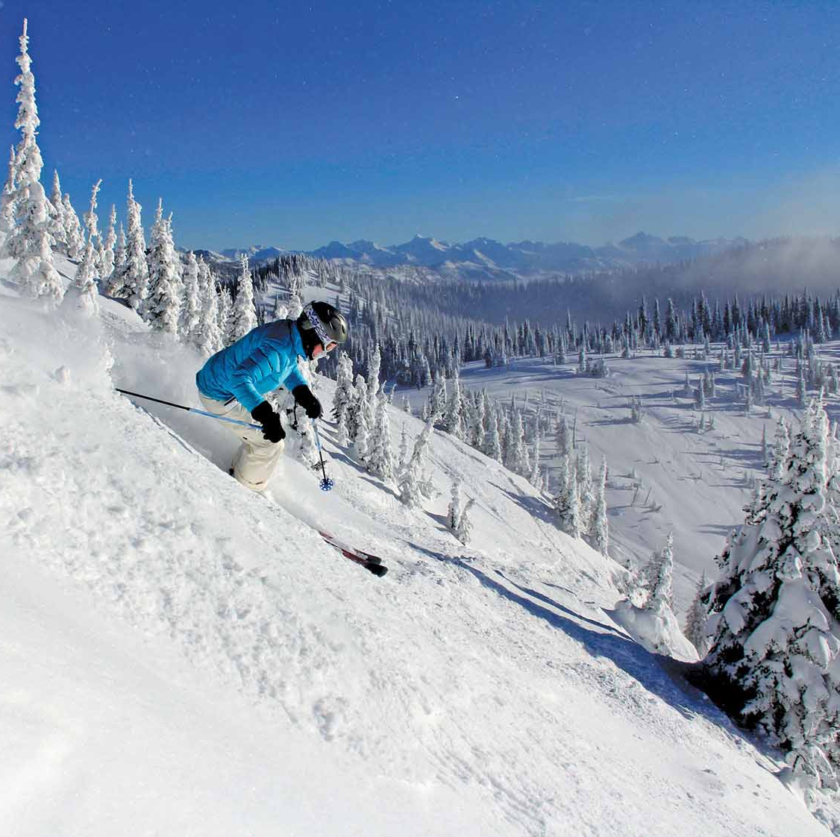
Project Goals:
Build a ticket price prediction model and give facilities investment suggestions.

Slide 5
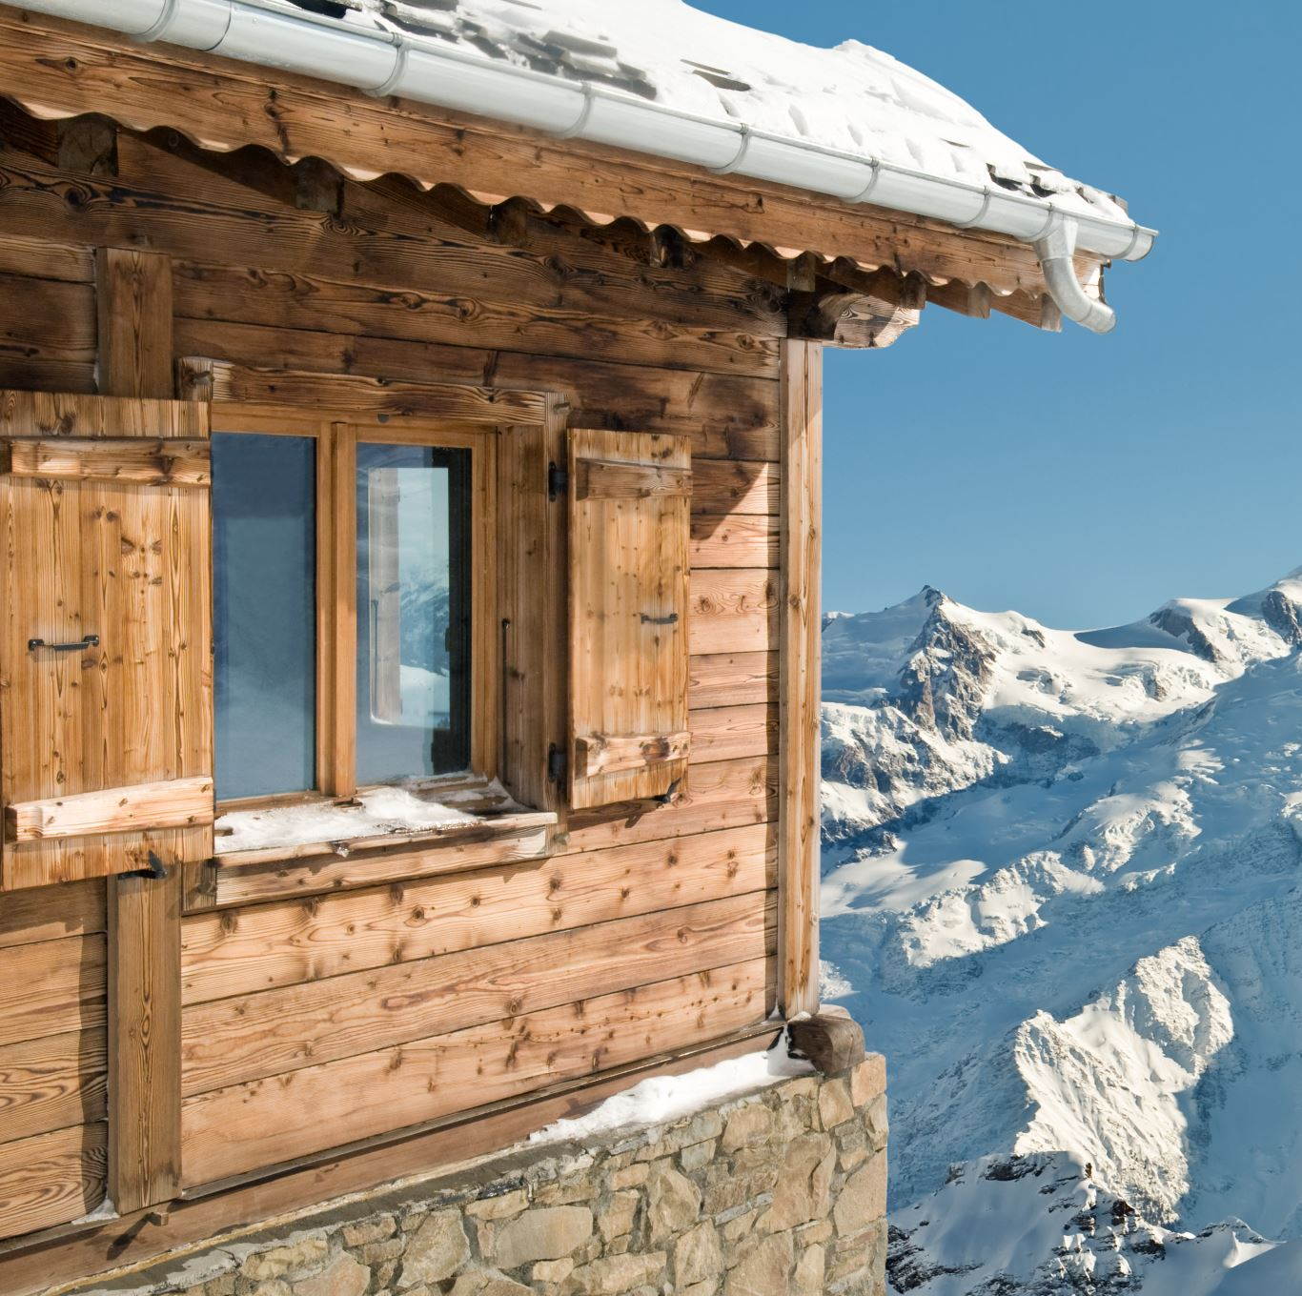
Recommendations
Pricing Strategy
based on the market position and facilities of Big Mountain resort, the model suggest the ticket price of Big Mountain should be $95.87, compared with current $81.00, there is room for the increase of ticket price.

Slide 6
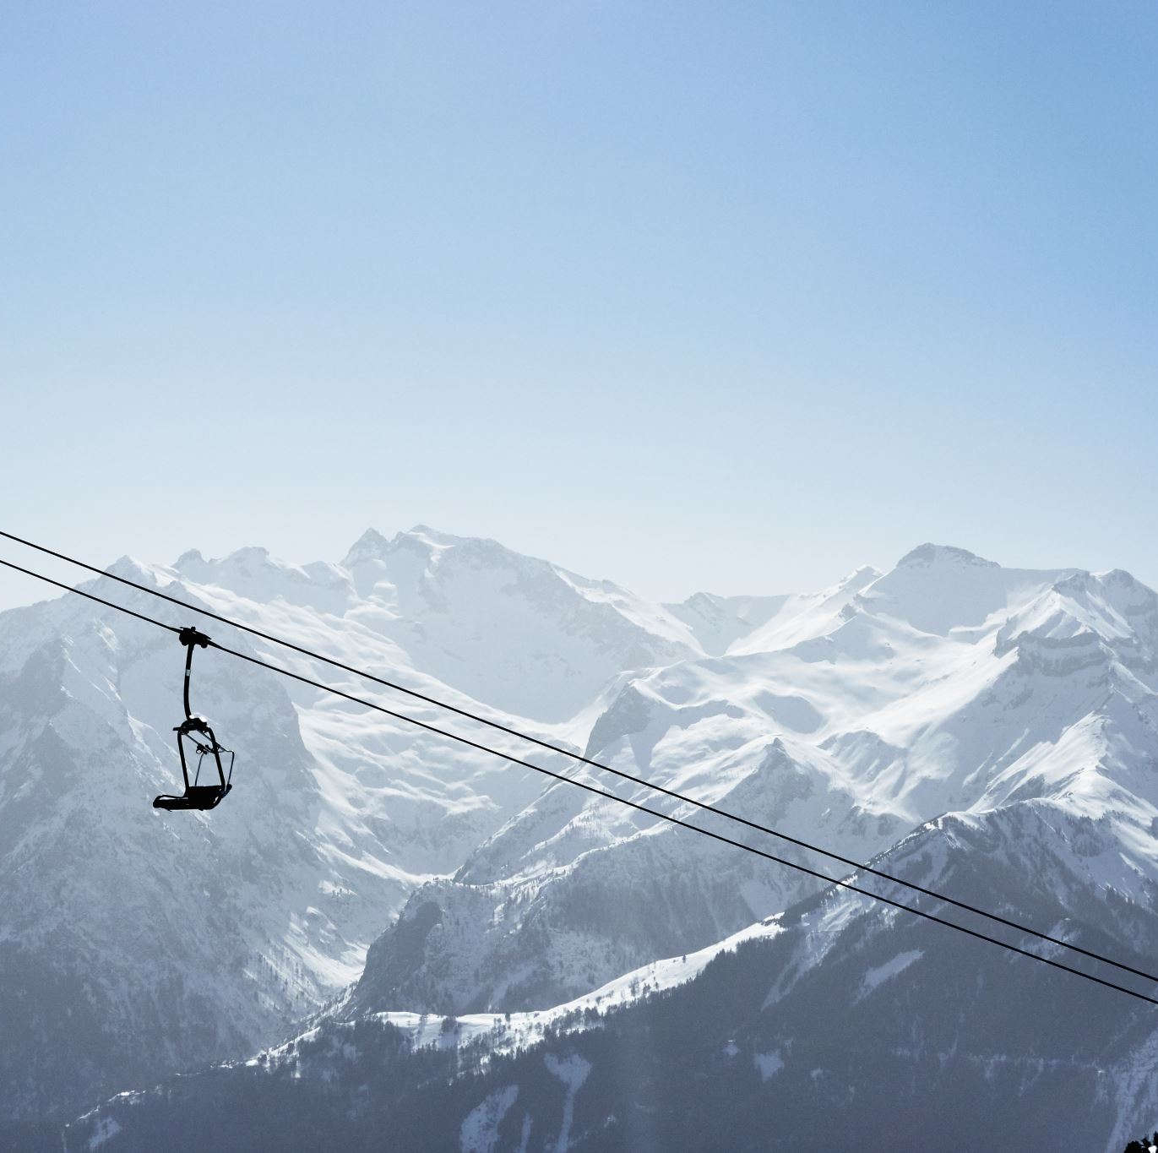
Recommendations
Facilities Investments
close one least used run, which will not influence the revenue.
increase the vertical drop by adding a run to a point 150 feet lower down with installation of an additional chair lift without additional snow making coverage, which will increase revenue roughly $3 million.

Slide 7
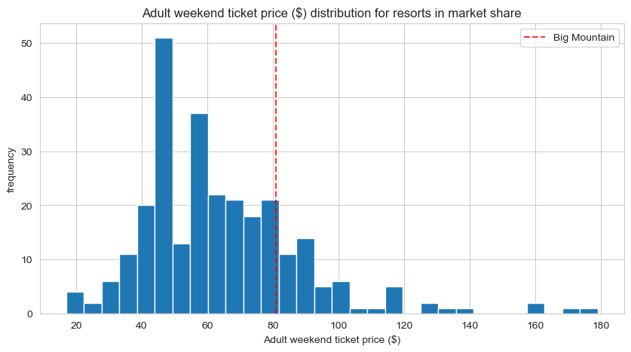
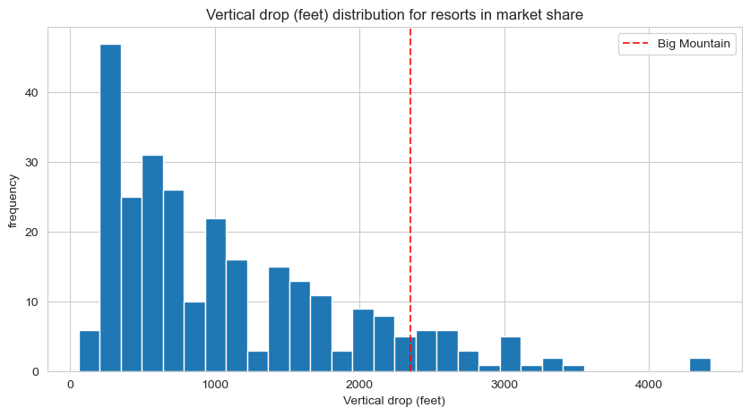
Big Mountain’s Ticket Price compared to other Resorts Ticket Price.
Big Mountain is doing well for vertical drop.

Slide 8
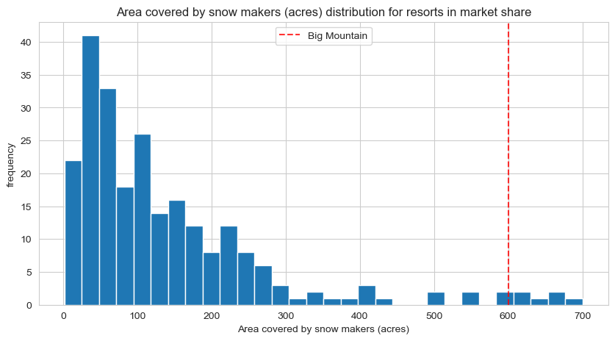
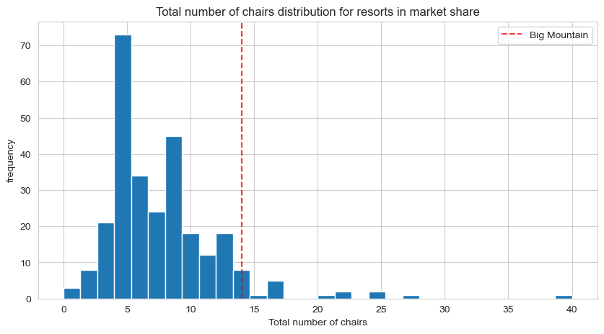
Big Mountain is very high up the league table of snow making area.
Big Mountain has amongst the highest number of total chairs.

Slide 9
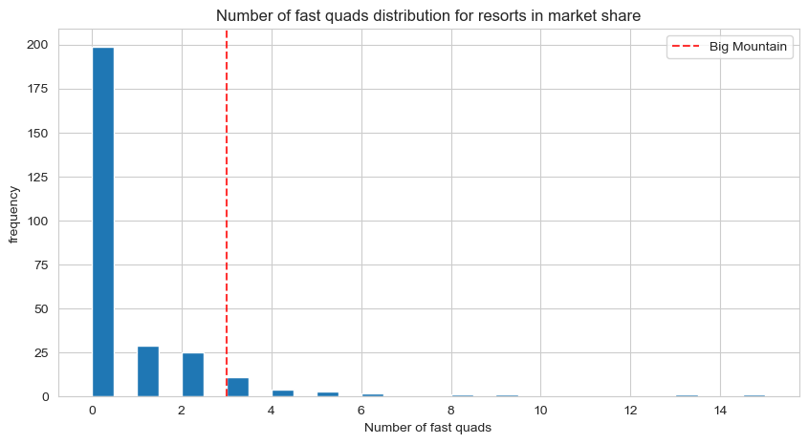
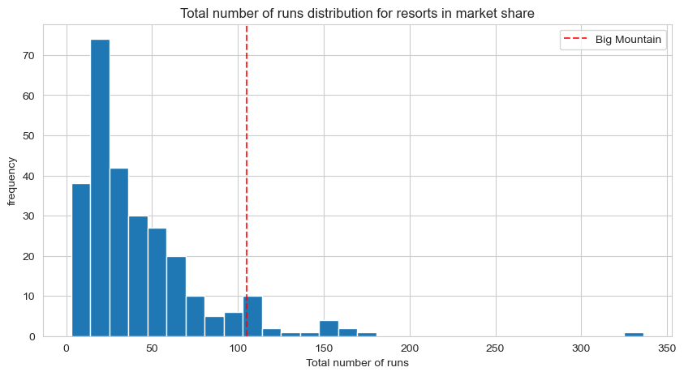
Most resorts have no fast quads. Big Mountain has 3, which puts it high up that league table.
Big Mountain compares well for the number of runs. There are some resorts with more, but not many.

Slide 10
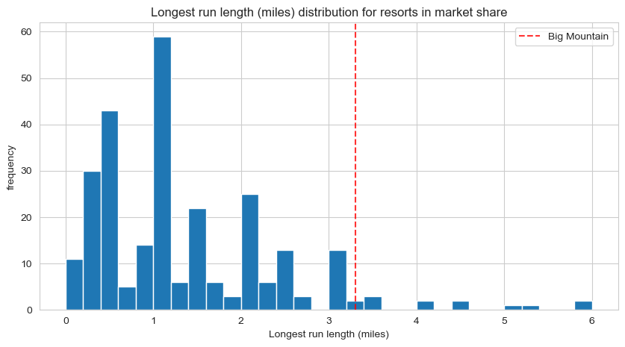
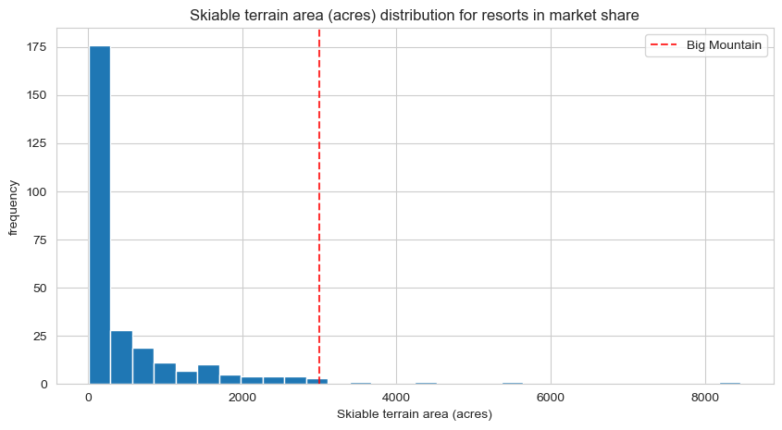
Big Mountain has one of the longest runs. Although it is just over half the length of the longest, the longer ones are rare.
Big Mountain has one of the longest runs. Although it is just over half the length of the longest, the longer ones are rare.

Slide 12

Conclusion
The ticket price has room for increasing and the revenues can be increased by facilities improvement.
The primary goal of this object is achieved.

